Slide 1
Team Frist Center

Slide 2
Github

Slide 3
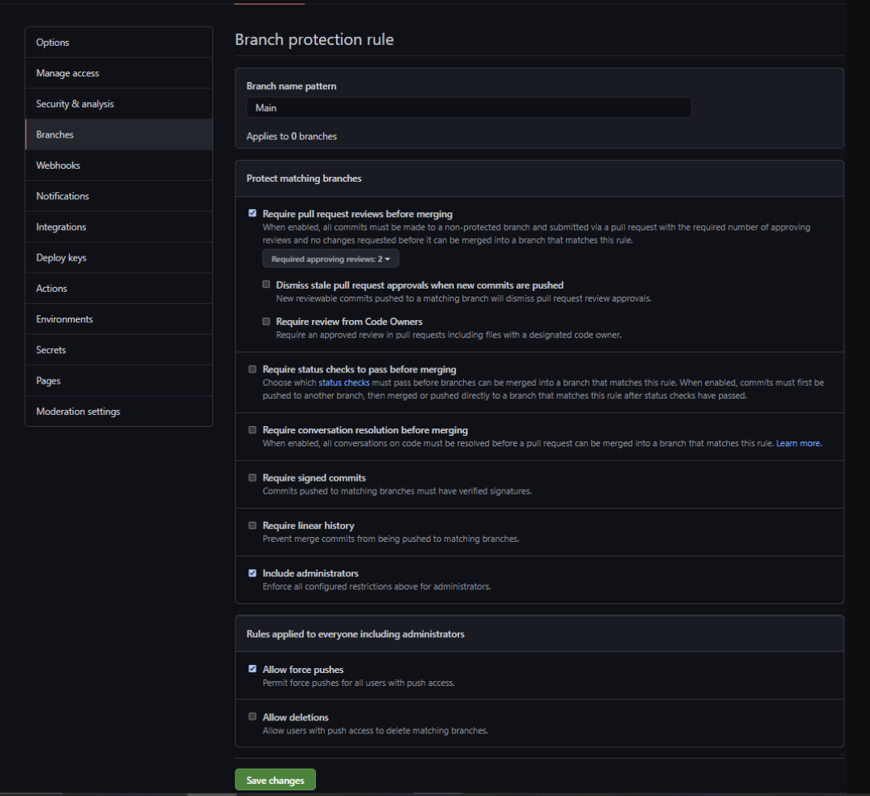
Getting Started
Set up main repository
Set up branches with teammates
Navigated Git terminal
Set branch rules
Started README

Slide 4
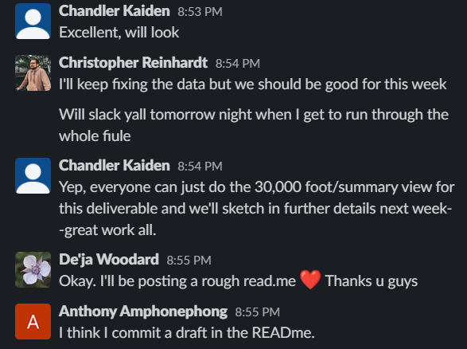
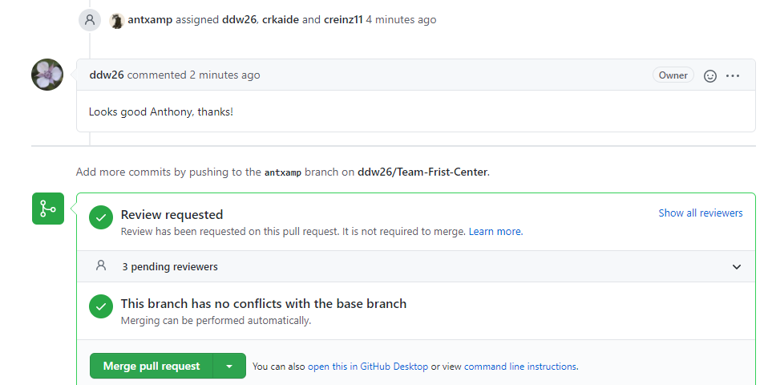
Communication Protocols
Our group utilized Github to give commentary on each other’s work. Slack, however, allowed us to share links, input, and insights more extensively and immediately.

Slide 5
Database

Slide 6
Intro
Using data from the National Oceanic and Atmospheric Administration (NOAA) website, this database:
Combines six source files into a single working dataframe
Reduces working dataframe from approx. 120k records to approx. 2.7k
Cleans and processes working dataframe
Creates two dependent dataframes (keys for machine learning, values for charts, graphs, and analysis)
Sends dependent dataframes to CSV
Performs exploratory analysis
Creates CSVs for SQL joining
Reads in comprehensive database from S3 bucket for AWS

Slide 7
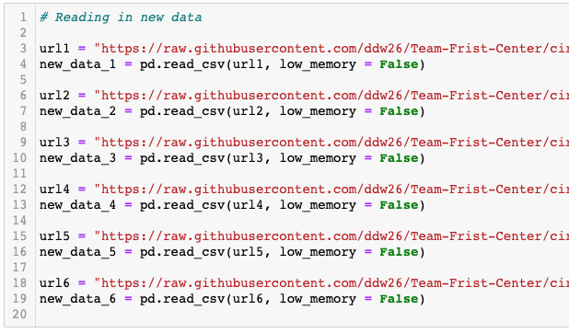
Working dataframe
Although we originally attempted to identify a single file as our data source, NOAA breaks datasets into multiple files.
Once we discovered this, we combined the 6 relevant files into our working dataframe.

Slide 8
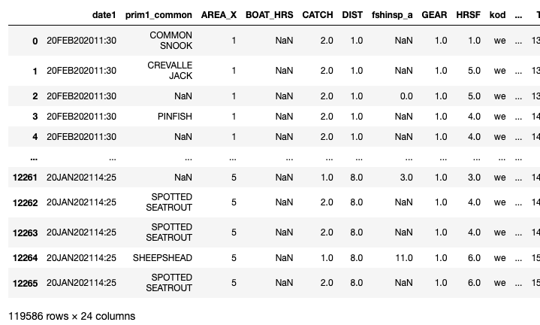
Working dataframe
Source files create a comprehensive database with 119,586 rows and 24 columns.

Slide 9
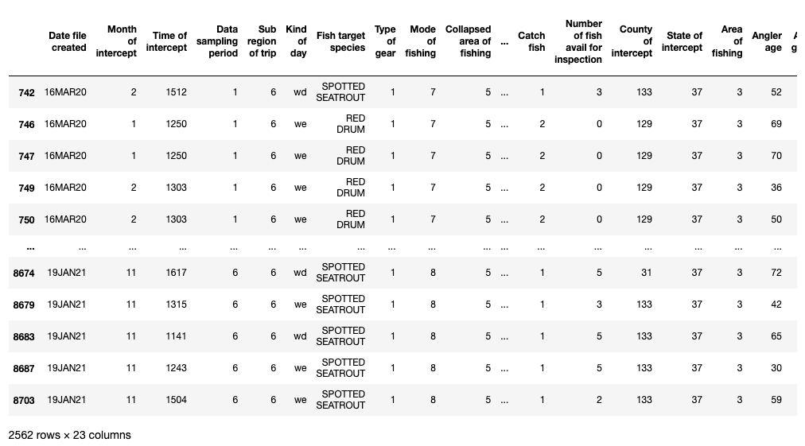
Working dataframe
Cleaning the working dataframe:
Drop NaN values
Rename columns for clarity
Reorder columns for clarity
Convert column data types
Remove unknowns

Slide 10
Working dataframe = 2,562 rows
Dataframe is reduced to approx. 2% its original size, an adequate number of records for analysis as well as the machine learning model

Slide 11
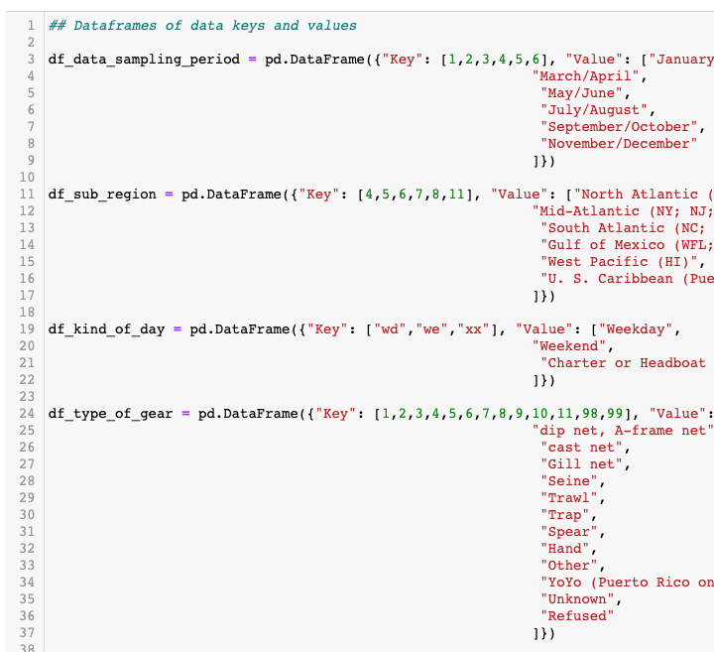
Dependent dataframes
Two variations on the same dataframe are needed to properly analyze this dataset: one that includes the key names of variables for charts, graphs, and the dashboard, and one that includes values for the machine learning model.
In this slide, we pass dictionaries into a new dataframe to replace values/integers with strings.

Slide 12
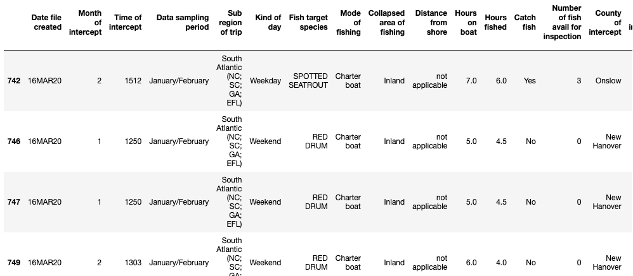
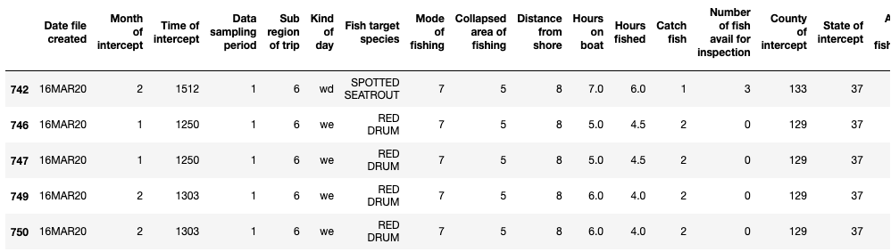
Dependent dataframes
Two dataframes, keys and values.

Slide 13
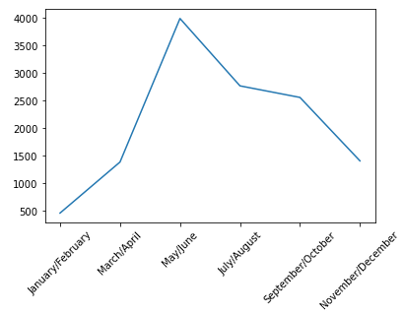
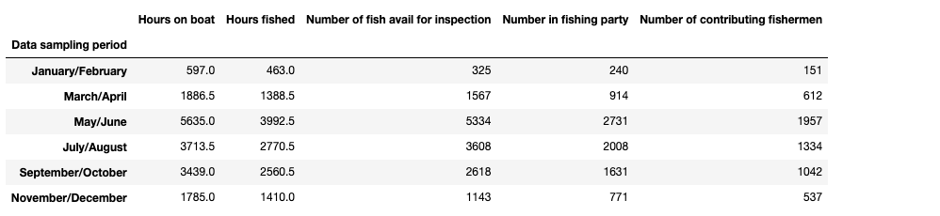
Initial exploratory analysis
Analytical dataframes and graphs generated:
Data sampling period, sums and averages
Kind of day, sums and averages
Target species 🡪 mode of fishing, sums and averages

Slide 14
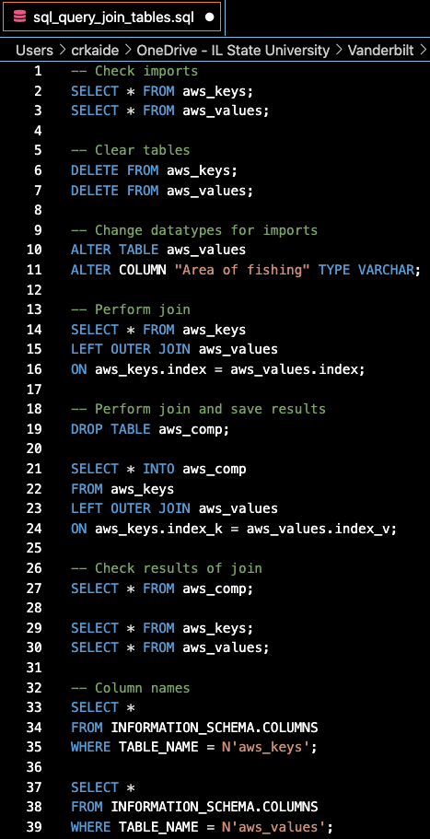
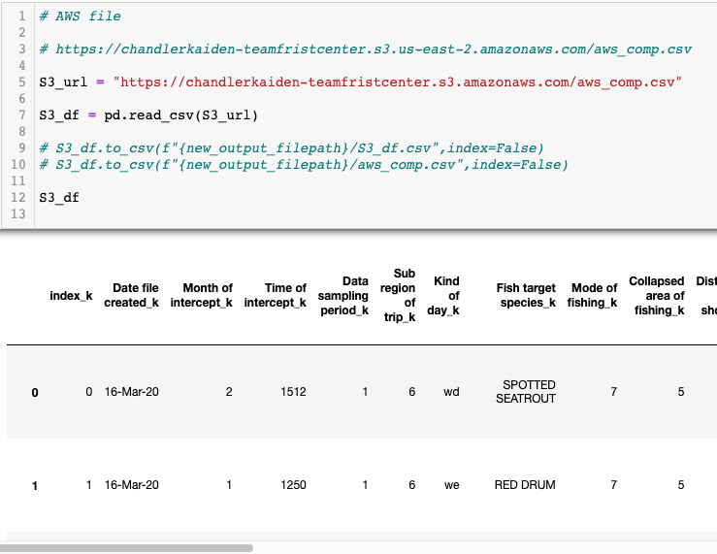
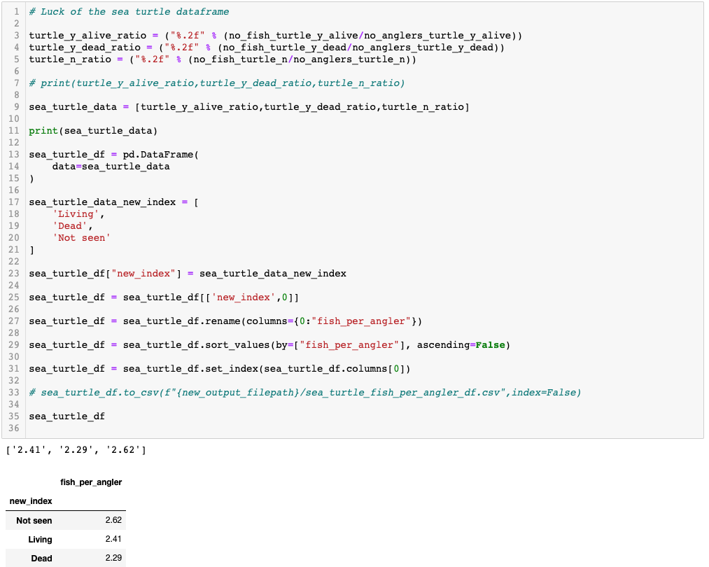
Database connections
Join dataframes in SQL
Send to S3 bucket for pickup by AWS
Read back into analysis file for add’l steps/dataframes

Slide 15
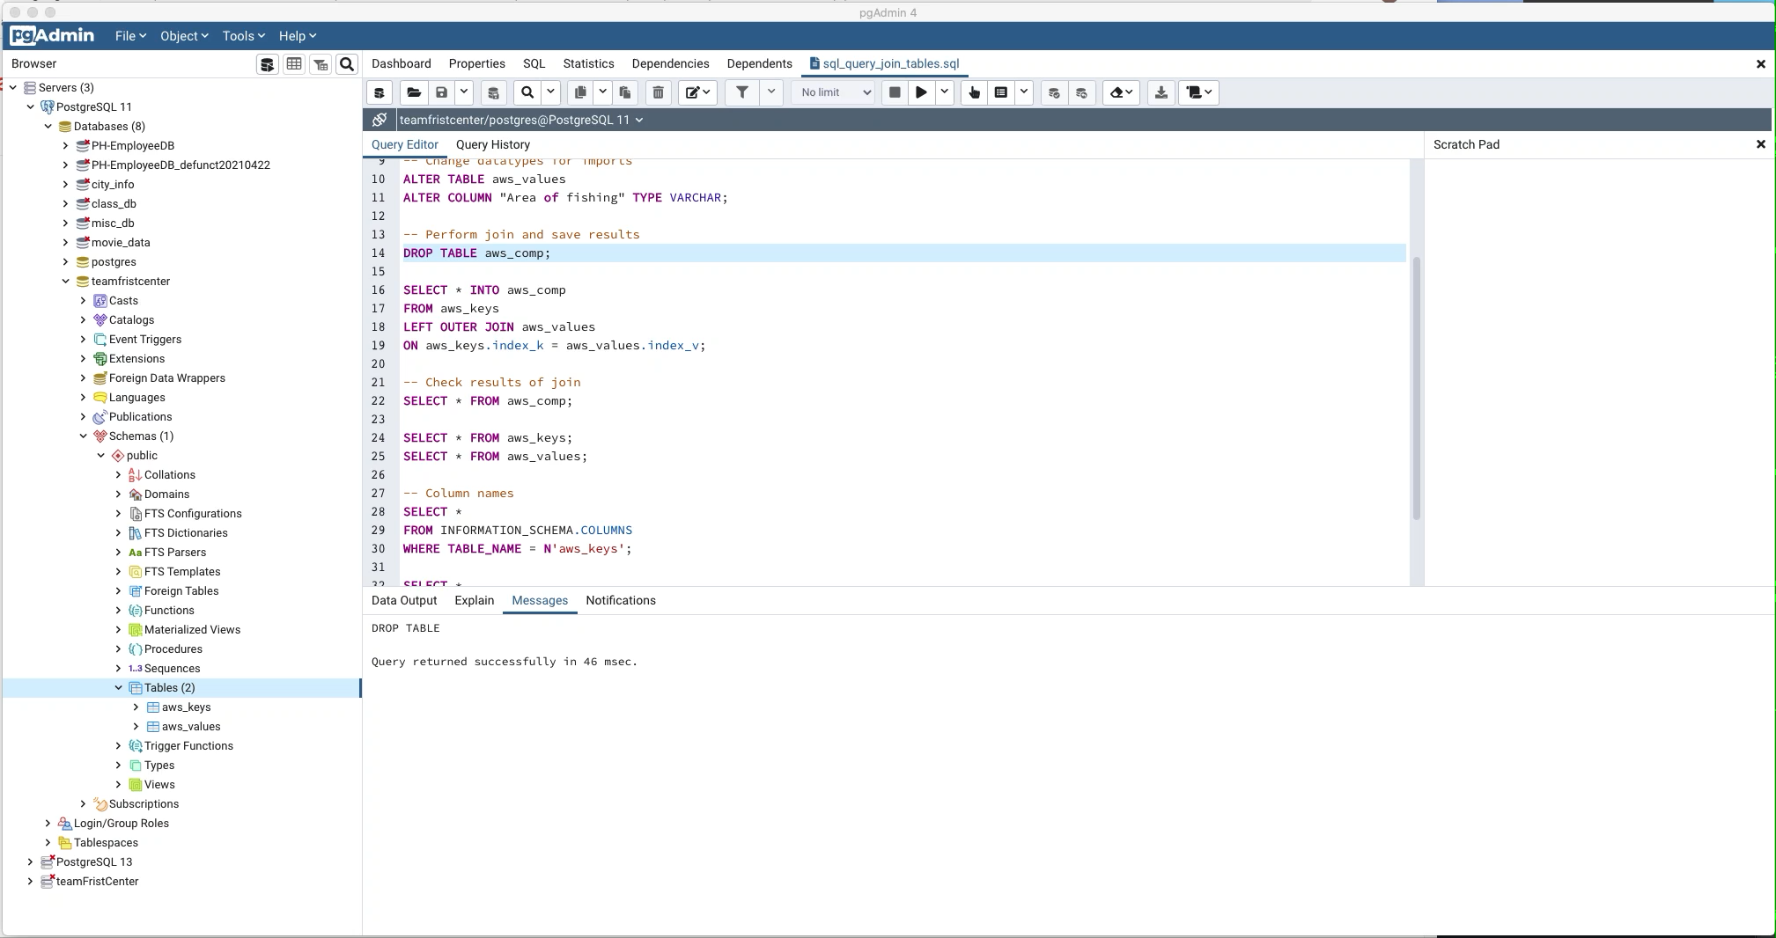
AWS Database

Slide 16
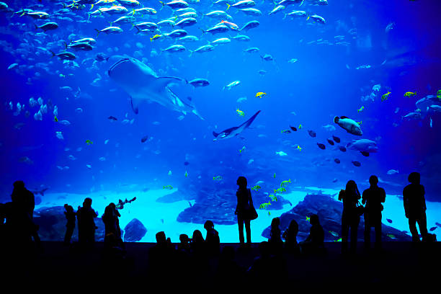
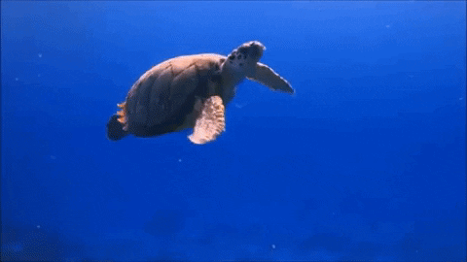
Database portion of pipeline terminates
Database picked up by machine learning model and Tableau dashboard

Slide 17
Machine Learning Model

Slide 18
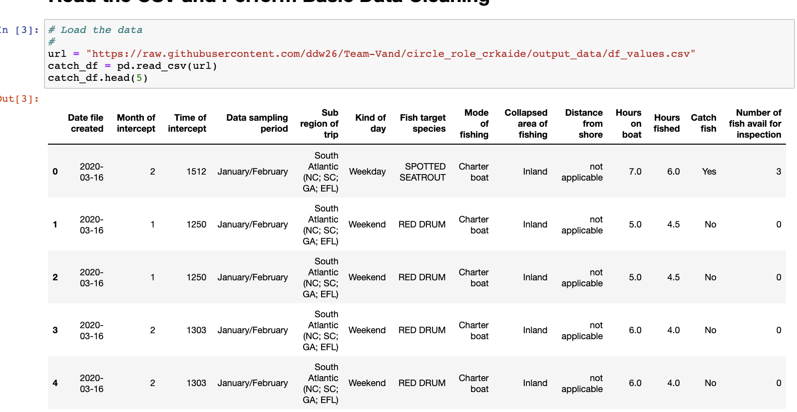
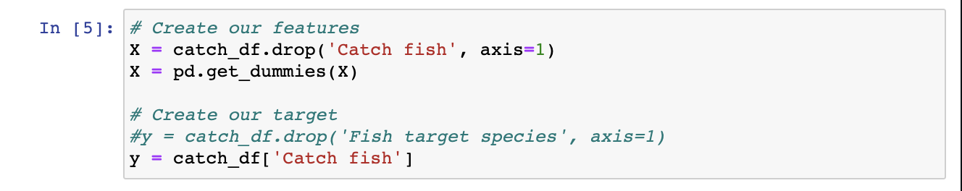
Defining our scope
Ingest source data
Refine fields to allow for a seamless machine learning experience
Identify our target question - “How likely will a fishing trip catch fish?”

Slide 19
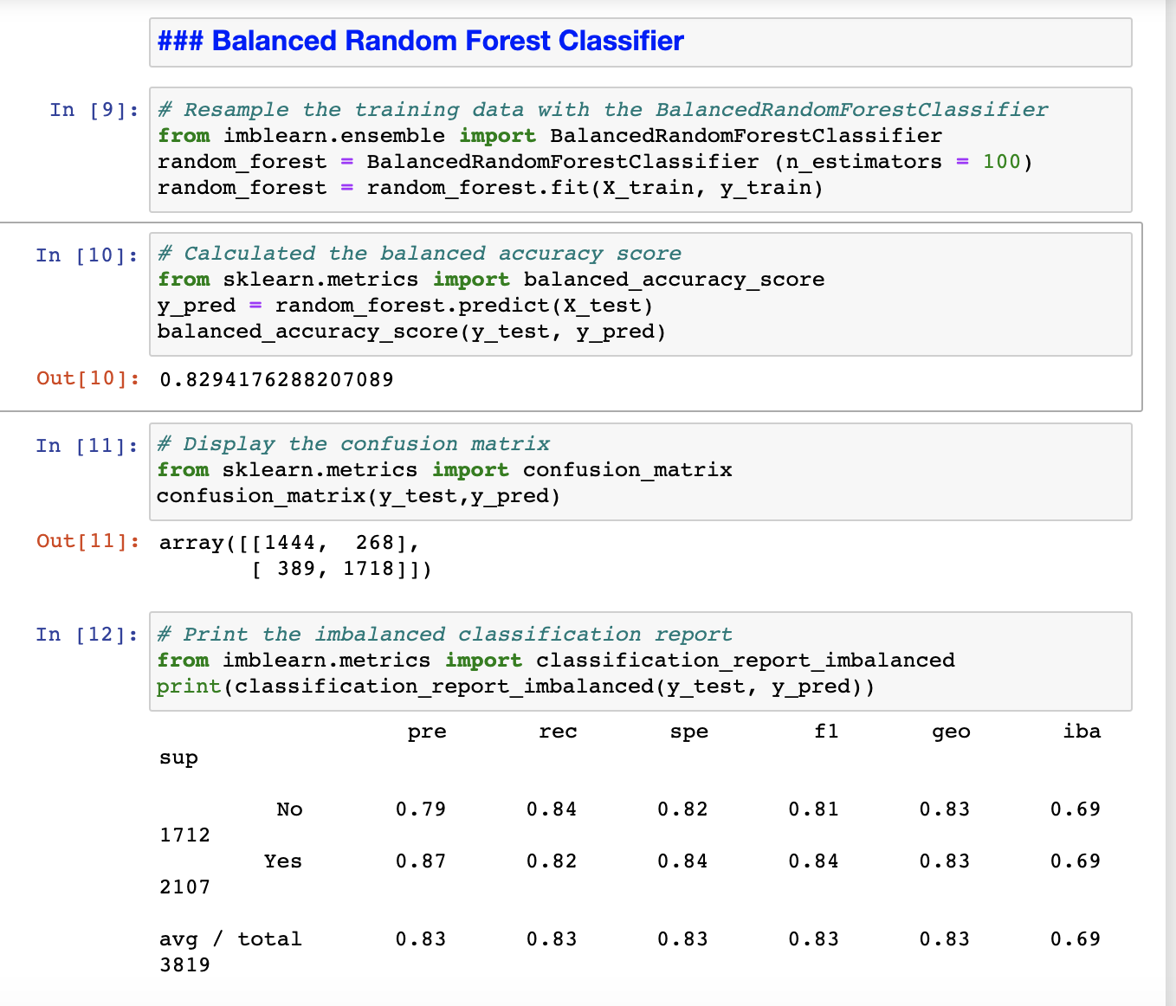
Model Selection & Results
Initial models tested: neural networks, random forests and Easy Ensemble
Give our data set and objective of predicting the likelihood of successfully catching fish, we decided to use Balanced Random Forest.

Slide 20
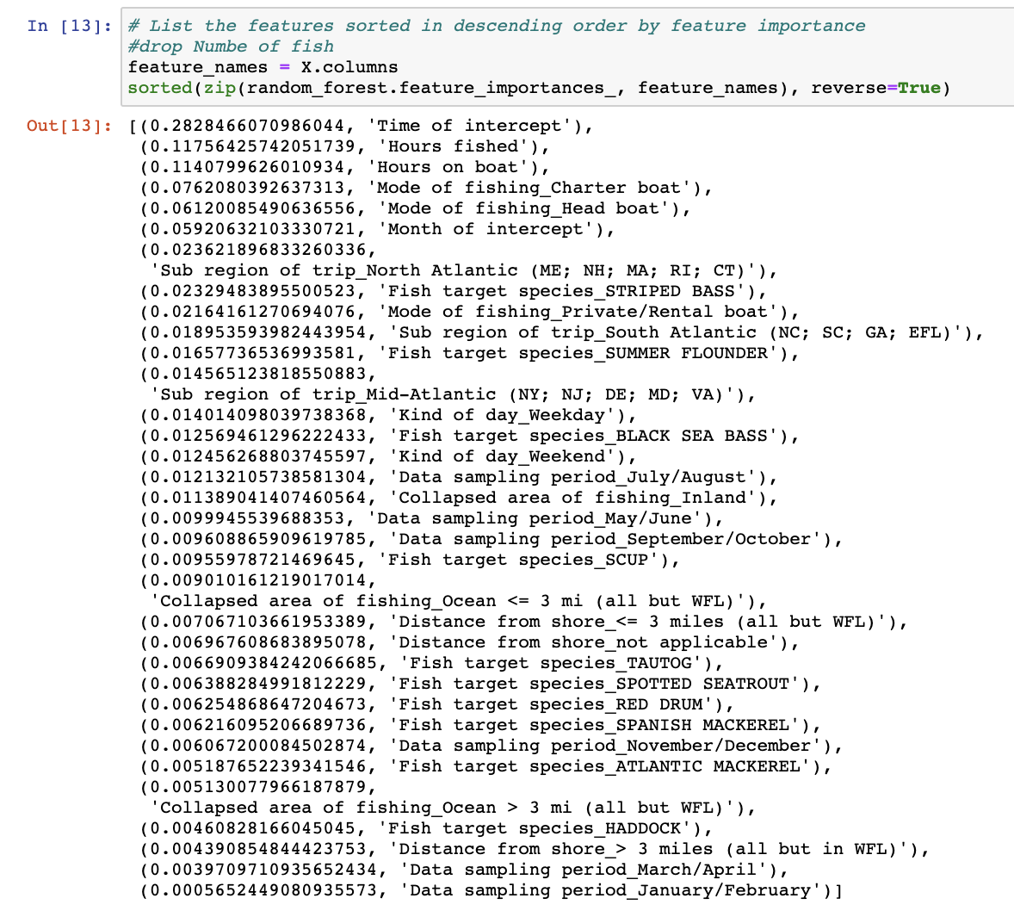
Model Selection & Results Continued
With this model, we were able to achieve an 83 % accuracy rate.
Initial challenge: identifying features skewing our model results
Hours spent on a given fishing expedition has the greatest impact on the models predictability of success

Slide 21
Visualization w/ Tableau

Slide 22
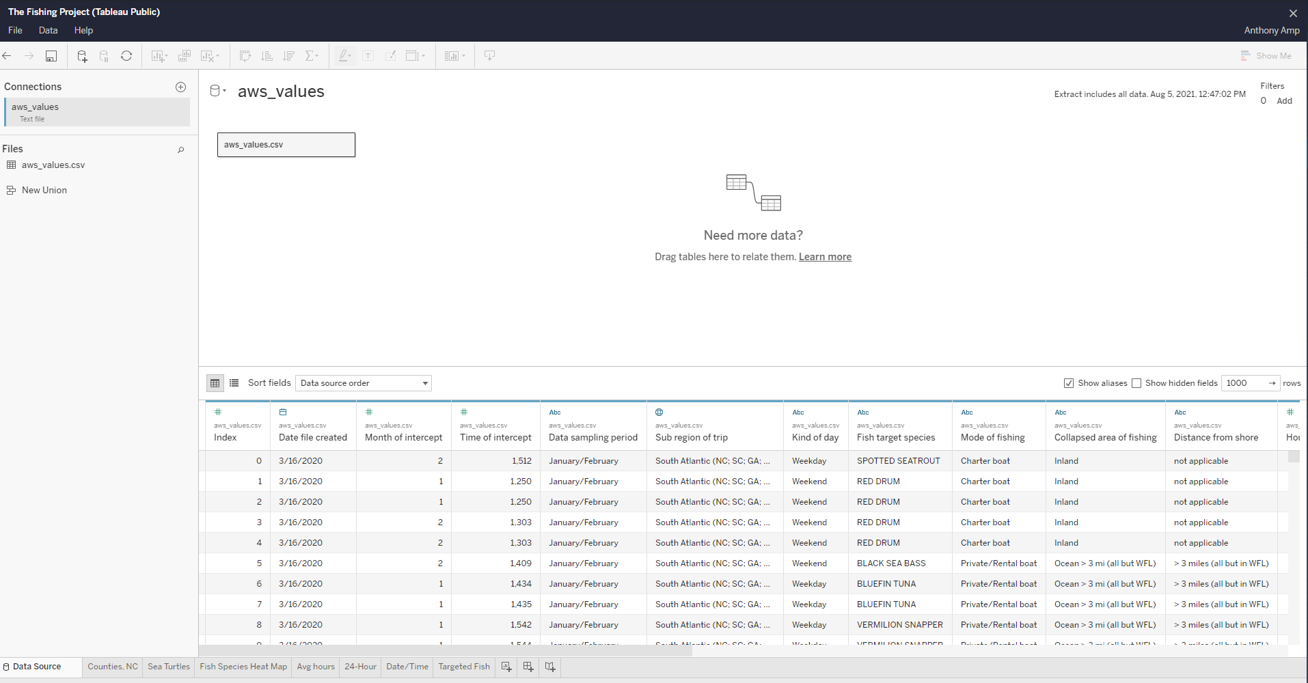
Connecting the data
Connecting with Tableau
We started with a clean data source and connected it by creating extract.
As you can see the extract to the data source was flawless.

Slide 23
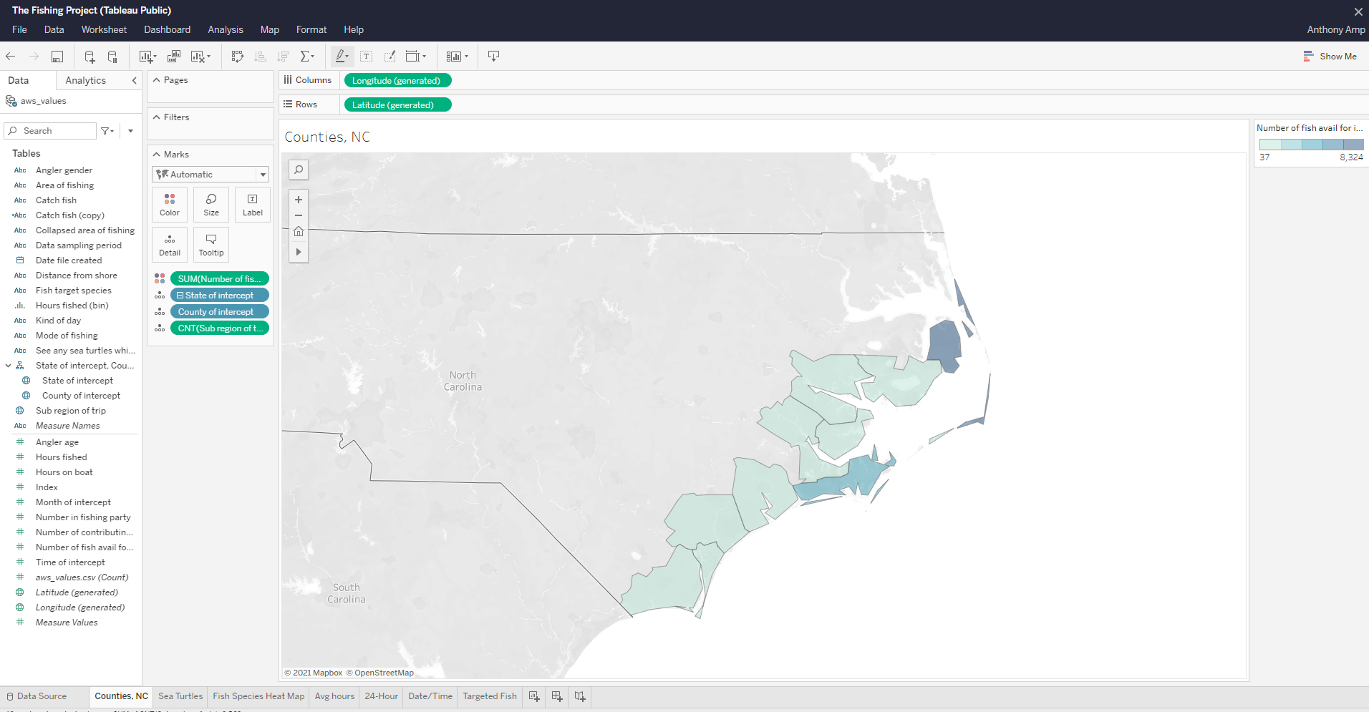
Creating the Viz
Creating a visualization after a successful data connection.
With the data source we were able to input the data such as coordinates to display geographical models.
Within this particular model you can see the amount of fish caught and reported within the coastal counties of North Carolina.

Slide 24
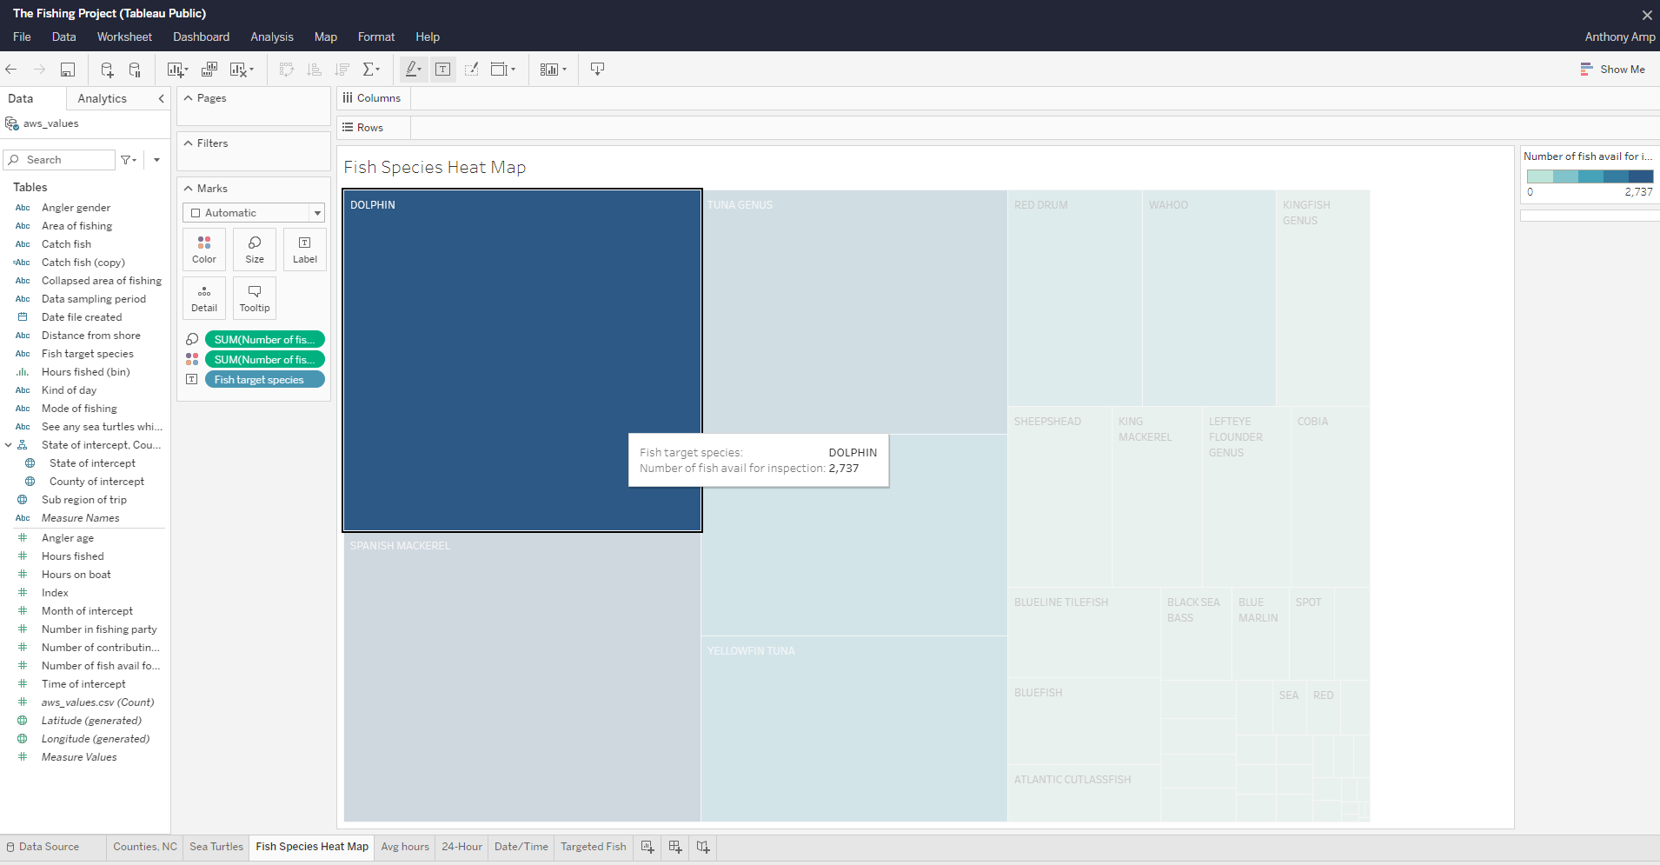
Creating Worksheets
Creating a worksheet with marks to inform user.
Here you can see the heatmap displaying information of popular catches within the calendar year.
The user can interact with the smaller boxes to see more information.
The bigger the box the higher the number of catch.
Don’t worry, the dolphins that were caught were released back into the ocean.

Slide 25
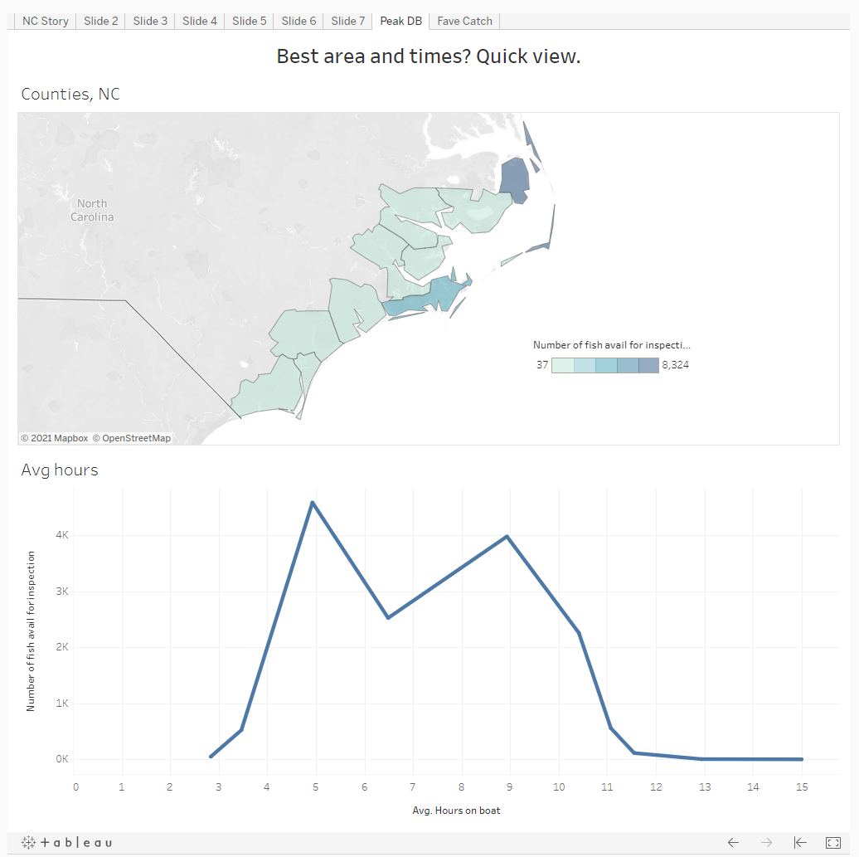
Creating a dashboard
Interactive Dashboard
With this dashboard you’re able to click around and identify the best area and times with just a quick glimpse. This was created using the Tableau dashboard options.

Slide 26
Final Results:
Project Purpose:
To create a prediction model about catching fish. The model will give a prediction on what conditions are favorable for the user so they don't end up going home empty handed!
We have data that shows the species of fish and we have North Carolina as a sample state with it's coastal counties.
We are wanting to show the different conditions in which the different species of fish have been caught successfully.
We want to be able to use the data to predict better outcomes for those that are wanting to spend money with private boats or charters.
To display the average amount of time spent on fishing with the data that was provided.
Use machine learning to predict the probability of a catch.
Project Results:
We were able to identify optimal conditions to fish.
According to the data the northeastern coast of North carolina projected a popular fishing destination.
After filtering the data were able to get a clear picture of what species were fished for and actually actually caught in the calendar year.
We learned that taking a charter yields better results comparable to private/rental boats.
Unless you just like sunbathing, we were able to get a good idea of how much time to fish/rent is considered optimal for potential cost purposes.
With the machine learning we were able to get a good percentage of successful catch within the region. With an 82% success rate.

Slide 27

Are turtle sightings goodluck? Lets see what some other cultures think:
Japanese – The turtle is a symbol of good fortune and longevity. The turtle is an positive omen bringing 10,000 years of happiness. The Cosmic Mountain and the abode of the Jennin are supported by a tortoise.
African – The turtle originated ju ju and appears in fertility rites. It represents the feminine to the serpent’s masculine power.
Greco – As the feminine power of the waters, the turtle was an emblem of Aphrodite/Venus in Greco-Roman myth.
Polynesian – The turtle symbolizes fertility and long life.
data sourced from www.allturtles.com

